Slide 1
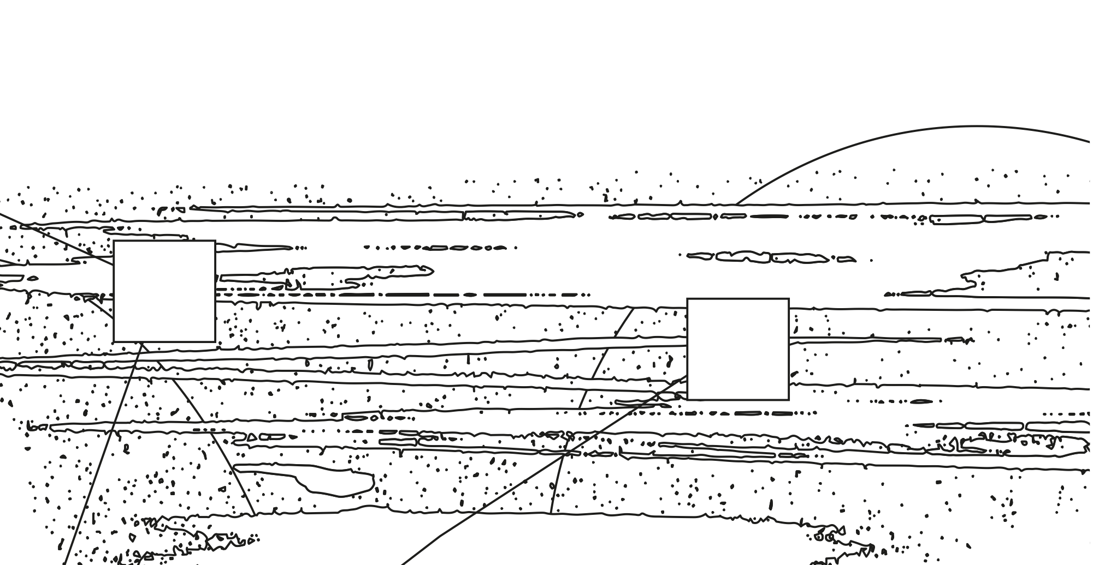
COMMUNITIES
AND FUTURES
List of educators

Slide 2
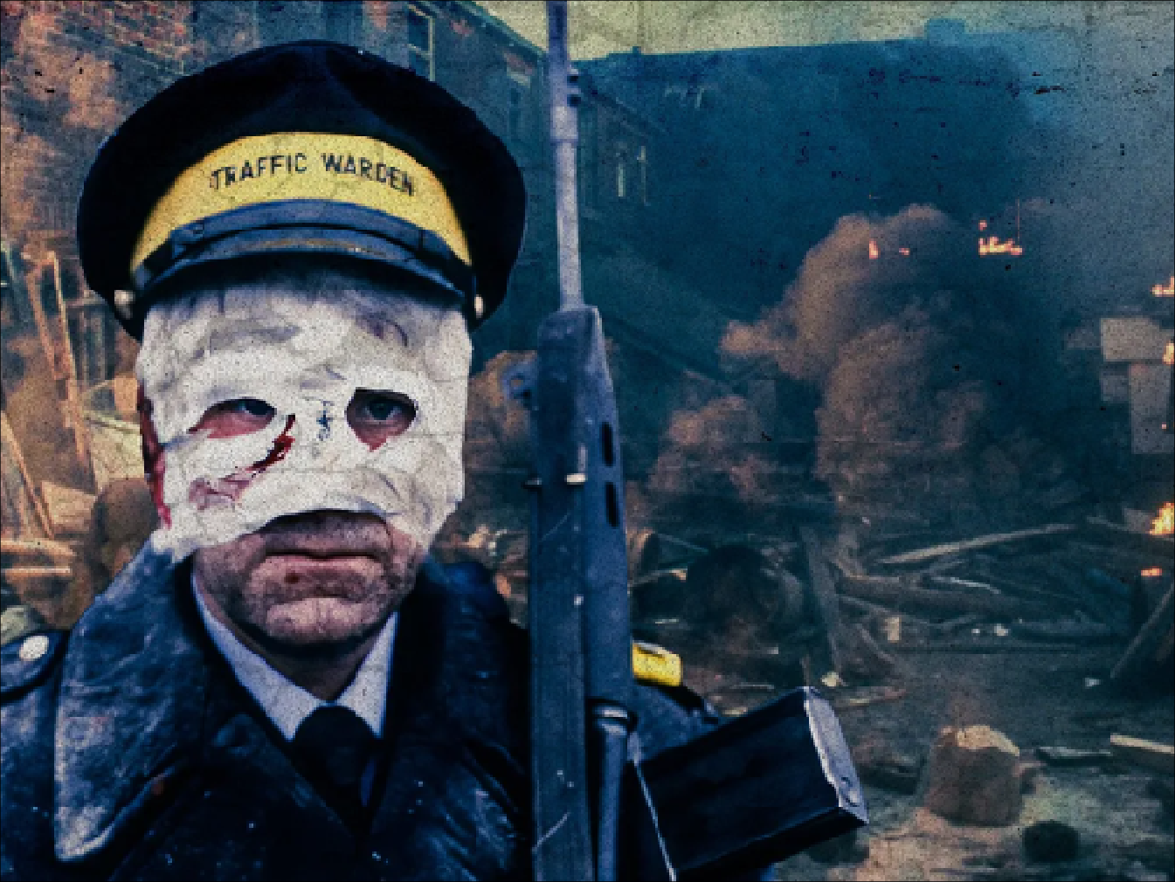
Threads, UK, 1984, Mick Jackson and Barry
Notes:
We are living in a time of polycrisis, when increasingly large portions of the population are asked to withstand multiple, overlapping, and mutually reinforcing emergencies. Two major global planetary threats associated with the so-called Anthropocene (or Capitalocene) are now intertwined—the nuclear threat reawakened from the Cold War and the omnipresent climate crisis. These destabilizing forces, real but difficult to grasp, stand to produce catastrophic scenarios, a future radically different from the bright horizons envisioned by the Western world in the second part of the twentieth century.

Slide 3
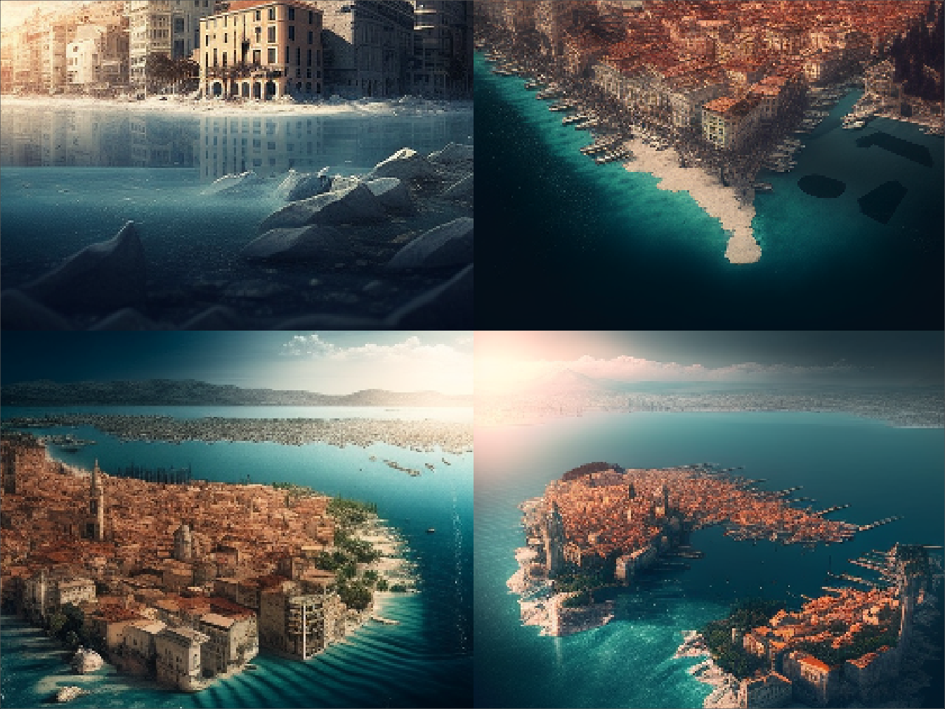
Imagine Split Croatia year 2080 climate changes, sea level rising,
midjourney, 2023
Notes:
Even more so, the future has been colonized by a dominant economic system grounded in extraction and solutionism, one that privileges technological quick fixes and private appropriation of the planetary commons. Despite frequent shocks, this system remains remarkably resilient to alternatives, sustaining a narrow imaginary of progress even as its contradictions intensify.

Slide 4

Temporal loop, Mitrović & Šuran, 2018
Notes:
The normalization of apocalypse generates a climate of fear, anxiety, paralysis, and melancholy, as a pervasive sense that the future has been foreclosed. Mainstream culture reinforces this narrowing. From popular media to political discourse, dystopia has become a dominant narrative framework, turning catastrophe into entertainment while rendering alternatives increasingly difficult to articulate. This saturation has generated what might be called a dystopian loop: the more we anticipate collapse, the more we organize the present in ways that bring about the very futures we fear.

Slide 5
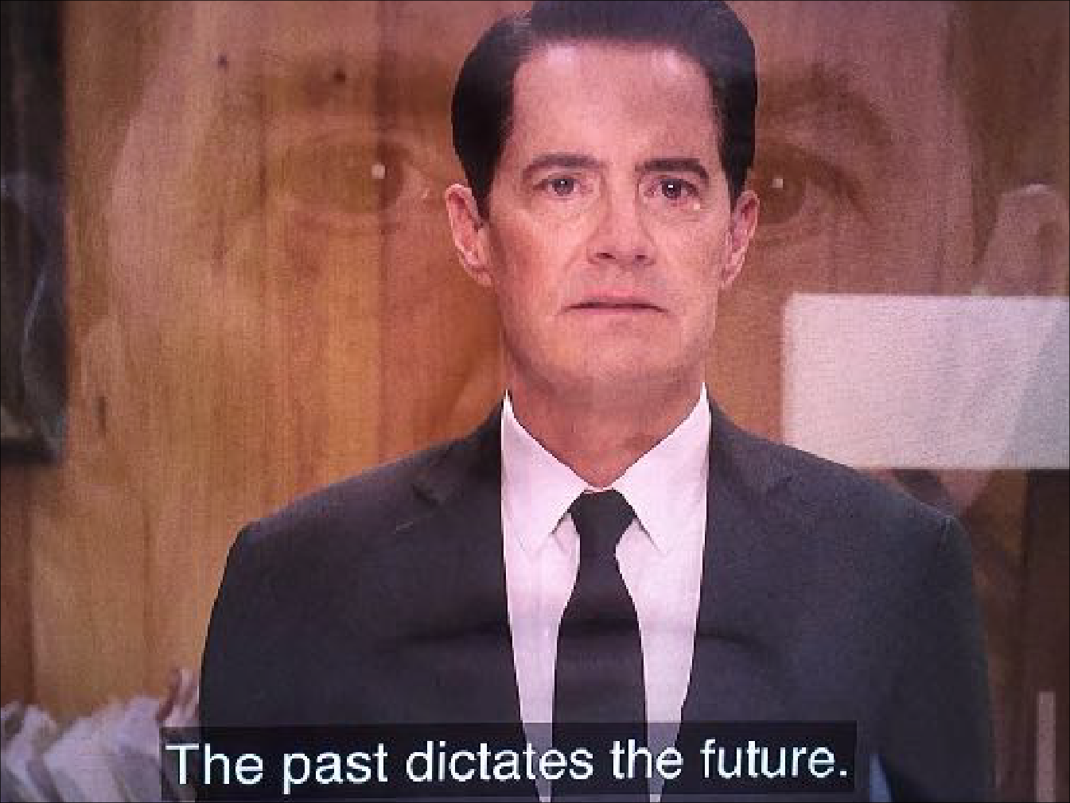
Twin Peaks, David Lynch, 1990, 2017
Notes:
Living inside this feedback system, many feel that the future has been taken from them. Agency becomes eroded, hope appears naive, and imagination loses ground to a melancholic limbo shaped not only by traumas of the past but by traumas anticipated in the future. This sense of temporal enclosure, of being caught between a damaged past and an uninhabitable future, makes the work of imagining alternatives more urgent, and more difficult, than ever.

Slide 6
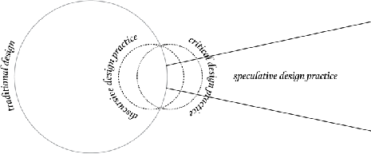
Traditional design vs Speculative design, Mitrović & Šuran, 2015
Notes:
Designers are particularly attuned to this tension. As a young discipline, design carried a certain hubris, imagining itself as a harbinger of a better future. Designers believed that by committing themselves to “good design”, which for most was synonymous with modernist design, they could bring about a world of fewer, better things. But through its deep entanglement with capital, design has helped produce the very conditions that now make that future less viable.

Slide 7

Western Melancholy, Mitrović & Šuran, 2018
Notes:
No matter its good intentions, as a mechanism for generating ever more stuff, design is complicit in the climate crisis, resource waste, extractive infrastructures, labor precarity, and the throwaway culture of consumption. Today, in every design school, biennale, festival, and fair, one finds an implicit acknowledgement of the planetary crisis—a low, toxic background hum that unsettles the very idea of design.

Slide 8
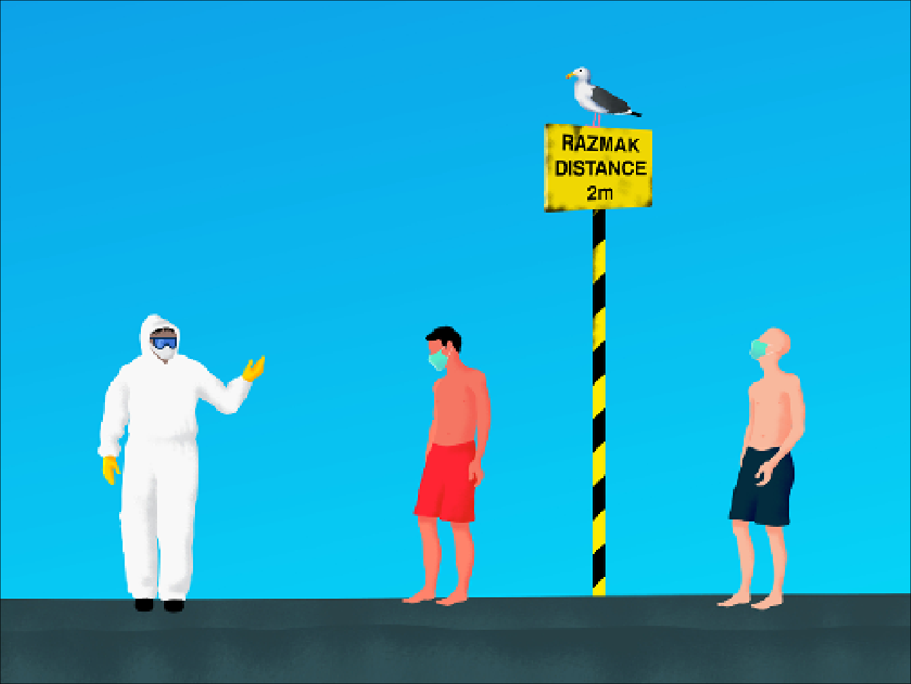
Summer 2020, Matija Sandrić, 2020
Notes:
At the same time, designers are, like everyone else, individuals trapped in a global state of emergency and increasingly burdened with the responsibility for systemic failures. Structural breakdowns are reframed as personal shortcomings; uncertainty, precarity, and risk are internalized as matters of individual resilience and self-management. As the Anthropocene narrative began framing humans as primary agents behind many of the world’s unfolding disasters, a parallel narrative emerged insisting that we are essentially powerless within the complex and volatile systems we inhabit.

Slide 9
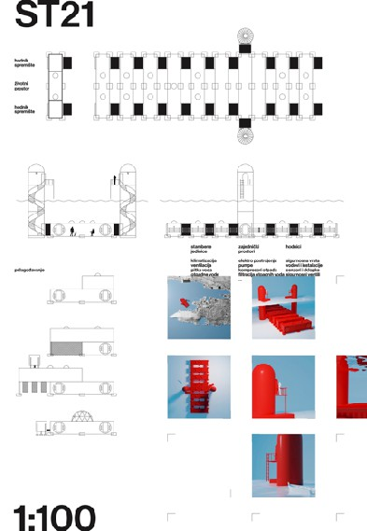
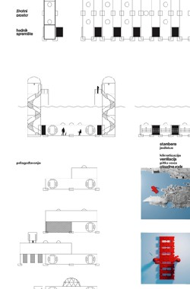

Homo Aquaticus: HABITAT ST21, Ivica Mitrović & Oleg Šuran, 2023
Notes:
The dominance of the market facilitates problematic relations to the elements that are chosen as part of the design process - in terms of resources, for example, the iPhone, comprises 75 of 118 elements from the periodic table (the human body is made up of around 30). In an article for the Los Angeles Times Brian Merchant described the pulverising of an iPhone and then analysing the resulting dust using mass spectrometry, X-ray fluorescence and infrared analysis. He suggests that to obtain the 100 or so grams of minerals found in a single iPhone, miners around the world have to dig, dynamite, chip and process their way through about 75 pounds of rock on nearly every continent.

Slide 10
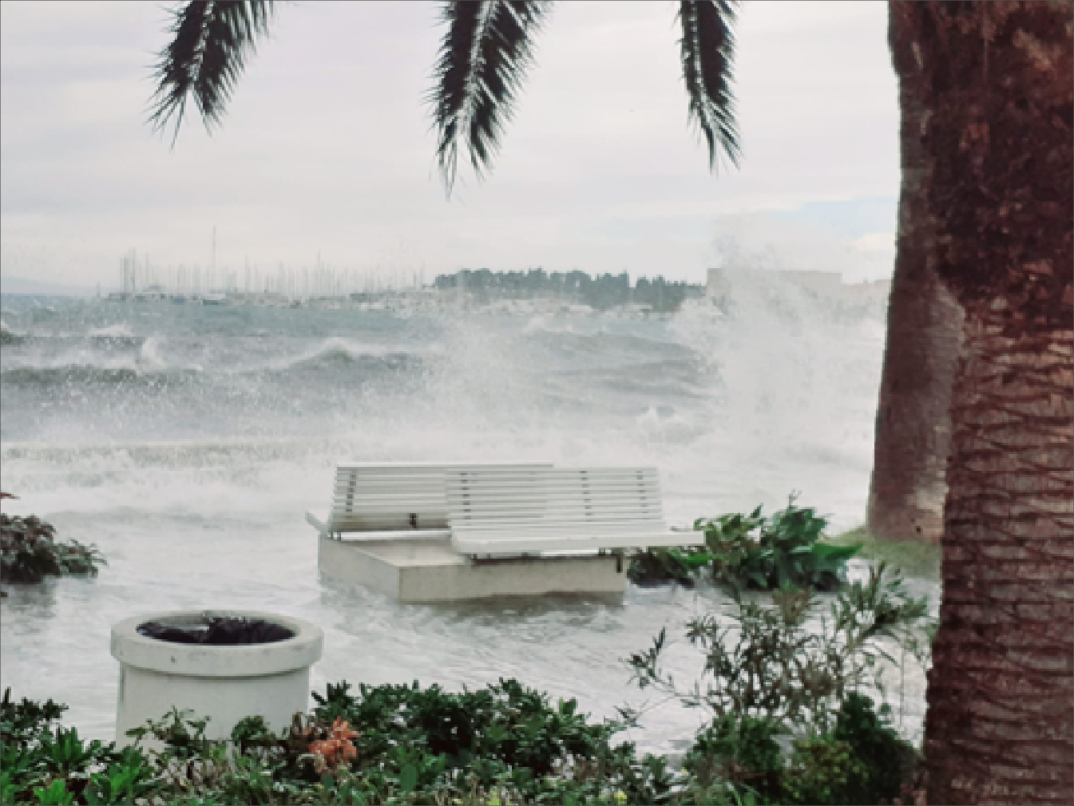
Homo Aquaticus: HABITAT ST21, Ivica Mitrović & Oleg Šuran, 2023
[Photo: Tamara Visković]
Notes:
The periphery is where these dynamics are often most sharply felt, although, as environmental breakdown driven by globalization accelerates, the planet itself risks being treated as a periphery. Away from urban and technological centers, designers’ work is frequently reduced to dealing with the implications of global threats on a local, micro level. The Adriatic is one such periphery. Repeatedly cast as a place where time appears to have stopped and where life is supposedly free from the uncertainties and stresses of “modern” existence. In this fetishized Mediterranean, one lives in an eternal present; the future never arrives, so there is no need to run from it. Absent from this vision are the multiple overlapping crises that have long shaped the region: wars, ongoing migrant crises, entrenched poverty, and the accelerating impacts of climate change.

Slide 11
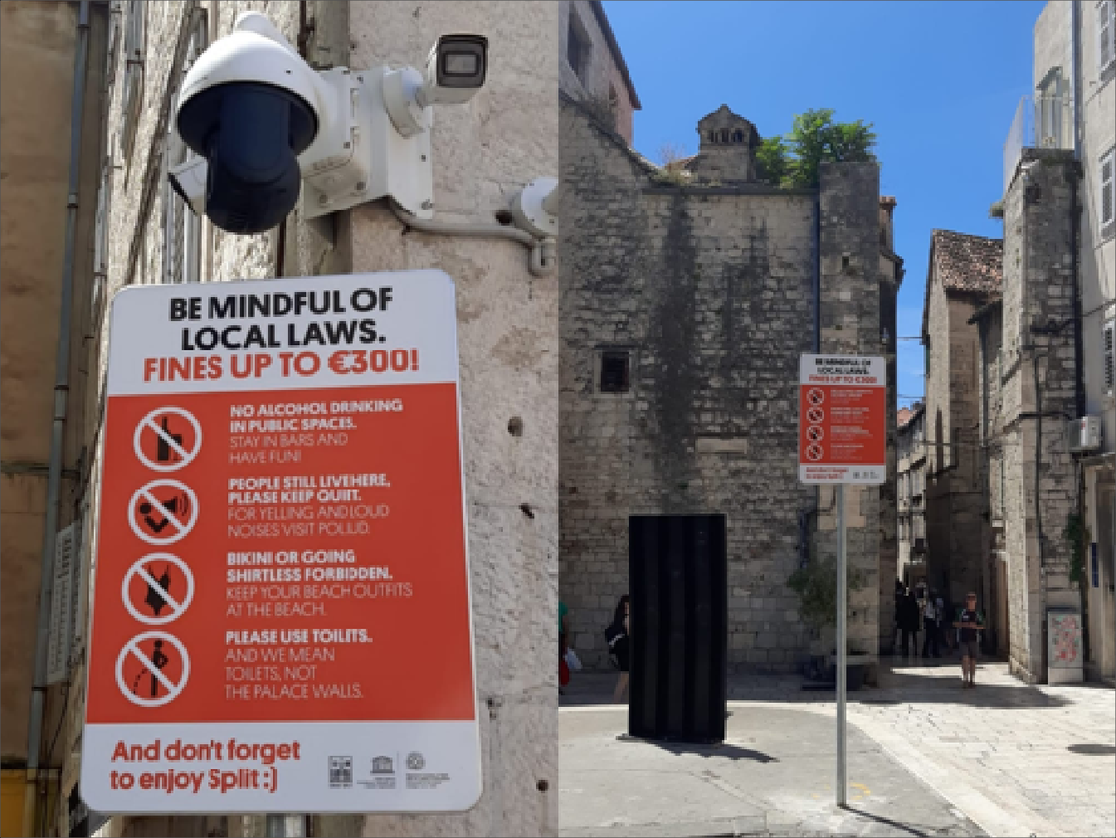
Homo Aquaticus: HABITAT ST21, Ivica Mitrović & Oleg Šuran, 2023
[Photo: The Ciity of Split]
Notes:
These places have become media and tourist commodities, their landscapes and inhabitants staged as scenographies for mass consumption, resulting in identities that are increasingly artificial and manufactured. At the same time, local populations struggle, often desperately, to resist these new forms of coloniality. Split, Croatia, is a particularly pertinent case study. After a period of aggressive deindustrialisation, it has experienced an even more aggressive “apartmentisation”—now the main source of income for many residents. Large industrial complexes that once employed thousands have been replaced by global hotel chains.

Slide 12
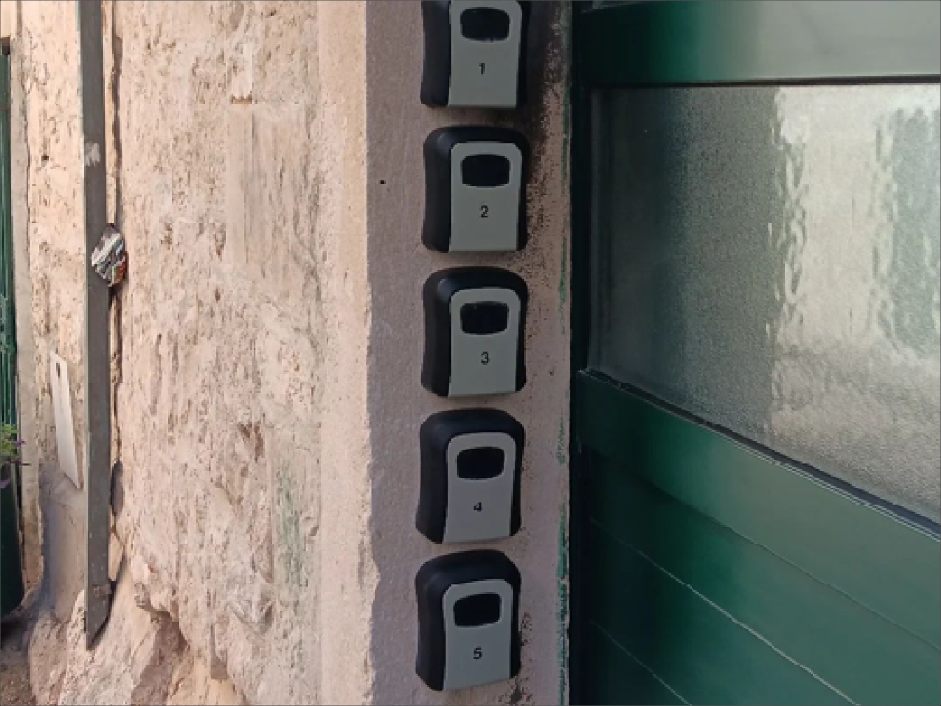
Homo Aquaticus: HABITAT ST21, Ivica Mitrović & Oleg Šuran, 2023
[Photo: The Ciity of Split]
Notes:
These places have become media and tourist commodities, their landscapes and inhabitants staged as scenographies for mass consumption, resulting in identities that are increasingly artificial and manufactured. At the same time, local populations struggle, often desperately, to resist these new forms of coloniality. Split, Croatia, is a particularly pertinent case study. After a period of aggressive deindustrialisation, it has experienced an even more aggressive “apartmentisation”—now the main source of income for many residents. Large industrial complexes that once employed thousands have been replaced by global hotel chains.

Slide 13
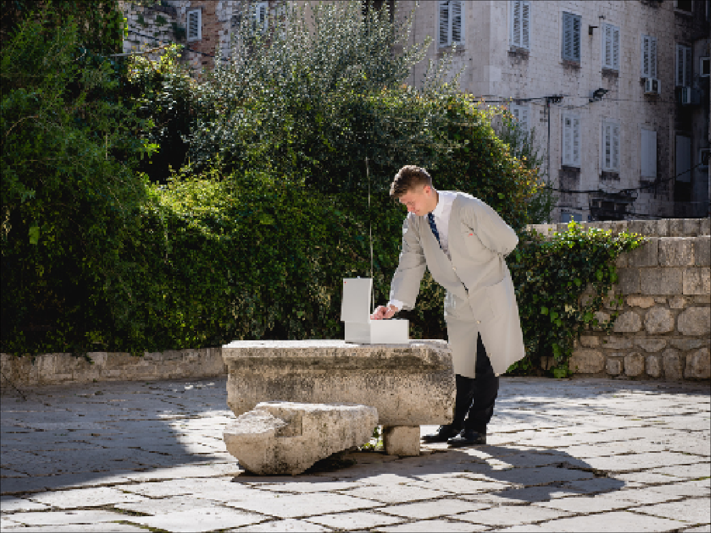
Southern Comfort, Mitrović & Šuran, 2016
Notes:
It is against this backdrop that the “Mediterranean speculative approach” has emerged—a practice that examines the future implications of major global changes (technological, economic, political, environmental) from within small urban and rural contexts through critical, speculative, and future-oriented design. In this framework, the periphery is understood not as a site of lack or marginality, but a space of opportunity for new forms of exchange and imagination precisely because of its location on the edges and borders of dominant systems and geographic centers.

Slide 14
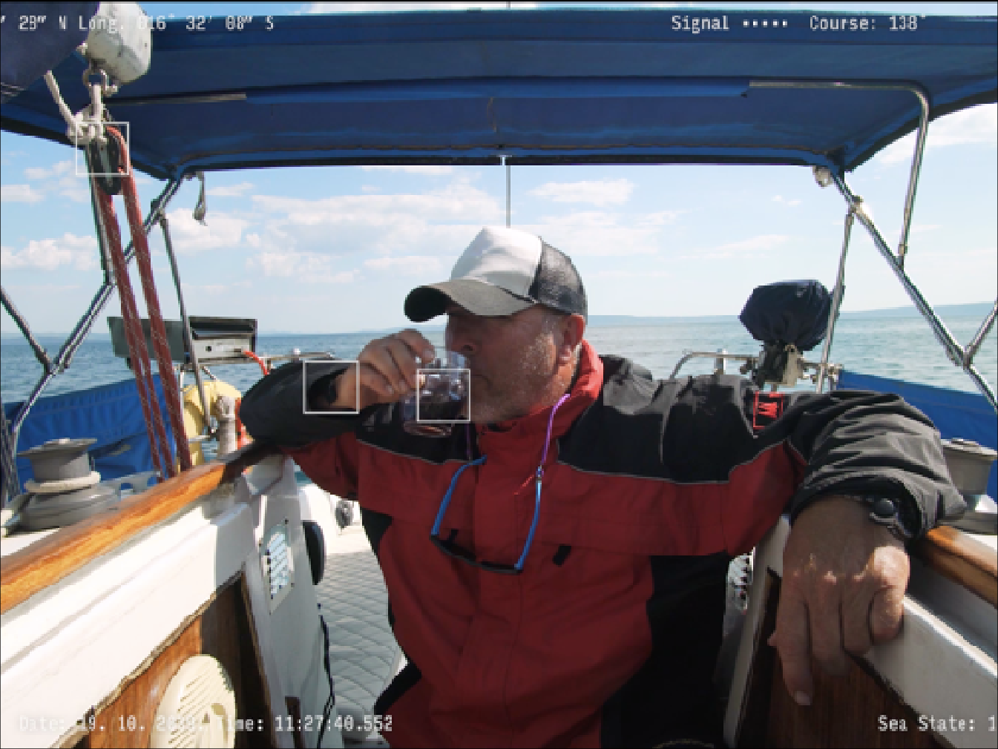
The Last Mediterranean Skipper, Mitrović & Šuran, 2017
Notes:
From this vantage point, local action can have global implications and resonance. Small-scale, bottom-up activities can achieve meaningful shifts, activating marginalized groups and offering new forms of hope within otherwise global dystopian constellations. Although these initiatives may not always produce immediate, concrete outcomes beyond the scope of individual projects, their value lies in the participatory process itself, moments when designers, experts, and community members jointly craft “real speculations” that open potential pathways for future action.

Slide 15
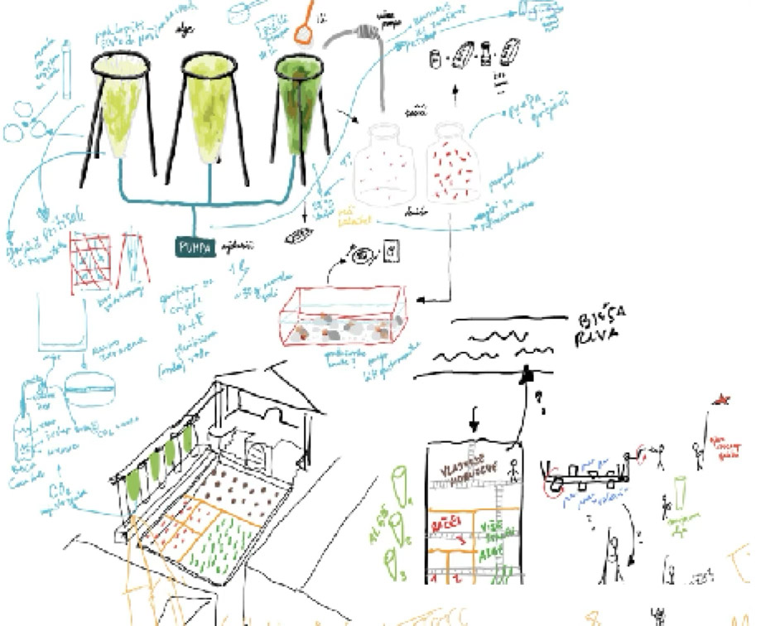
Asphalatos 2055 – Life After Tourism, Mitrović & Šuran, 2018
Notes:
For example, the Life After Tourism project (2018) confronted global challenges through a distinctly local lens. It set out to imagine alternative scenarios to anticipated dystopian climate futures by proposing that, in 2055, Split’s Perystile—the Roman-era square in the city's historic core—would become submerged by rising sea levels and transformed into a site of mariculture. Surrounding buildings would become spaces of production: drying, preserving, packaging, and preparing food for distribution.

Slide 16
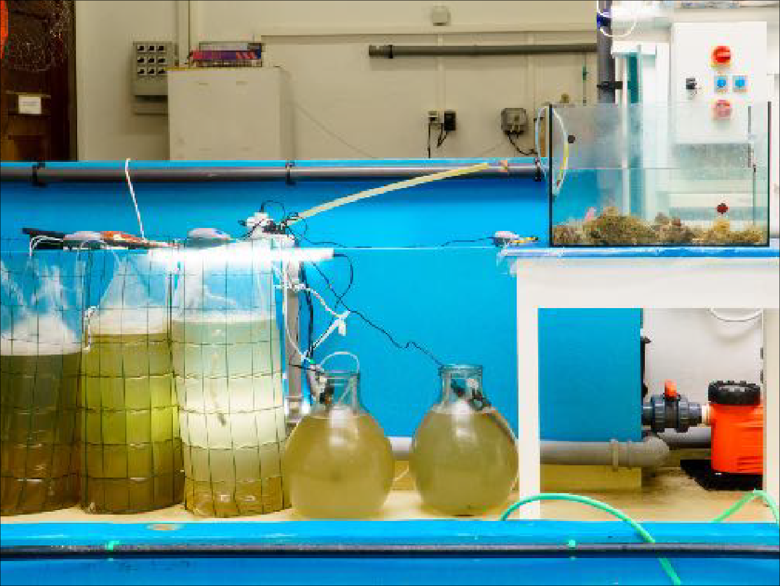
Asphalatos 2055 – Life After Tourism, Mitrović & Šuran, 2018
Notes:
The project was realized as a functional micro-mariculture system capable of cultivating climate-resistant marine organisms such as microalgae, brine shrimp, and sea anemones. These organisms were envisioned as both a food source for the remaining urban population and as the foundation for a new economy, a form of hope after catastrophe. From the outset, the intention was to expand the project’s reach beyond merely raising awareness, generating debate, and drawing attention to potential future scenarios.

Slide 17
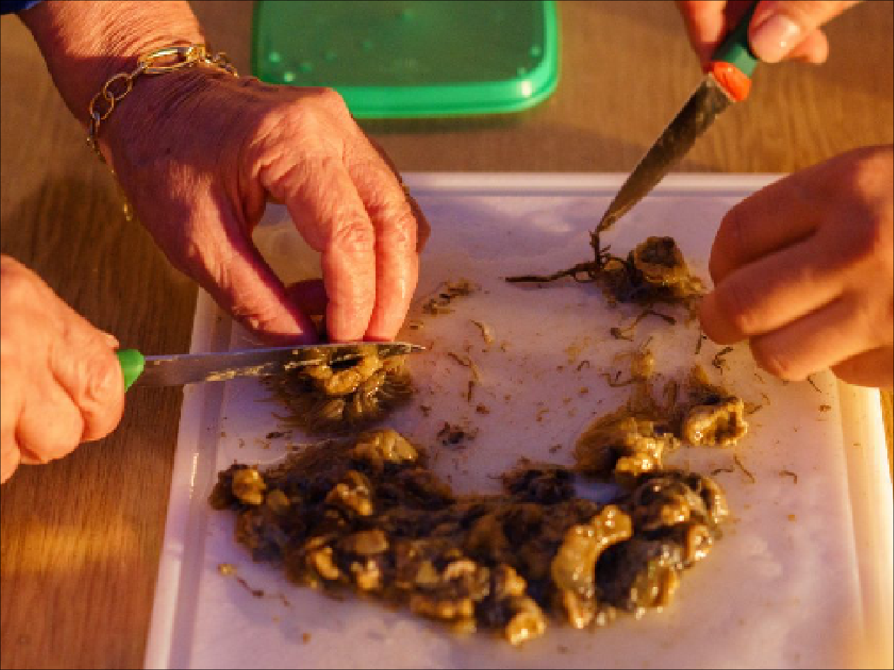
Asphalatos 2055 – Life After Tourism, Mitrović & Šuran, 2018
Notes:
The project aimed to extend speculation into action by providing concrete tools, techniques, and mechanisms that might help individuals and communities build life after collapse. It grew from a collaborative process in which designers from the Arts Academy, and experts from the Institute of Oceanography and Fisheries combined their respective forms of situated local knowledge and disciplinary expertise to produce a fully operational system. The project was paired with a DIY manual that translated this shared knowledge into detailed, actionable instructions for the wider community to adapt and apply in real-world contexts.

Slide 18
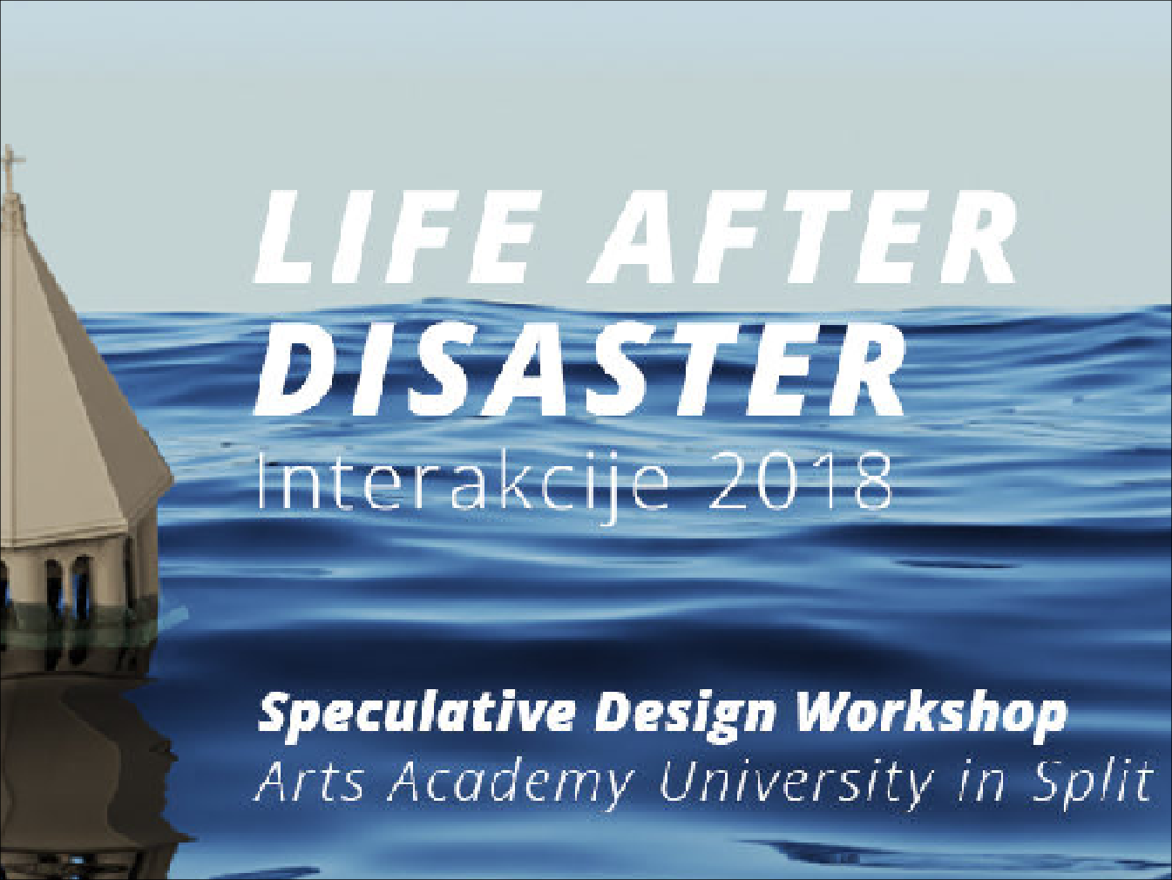
Life After Disaster WORKSHOP, Interakcije, Arts Academy, Split, 2018
Notes:
From the outset, one of the aims of our approach has been to bring the knowledge and experience generated through both discursive and practical work directly into education. Multidisciplinary workshops play a central role in this process. They employ critical and speculative methods as a unifying framework and introduce alternative educational models that move beyond slow and constrained rhythms of curriculum-based academic programs.

Slide 19
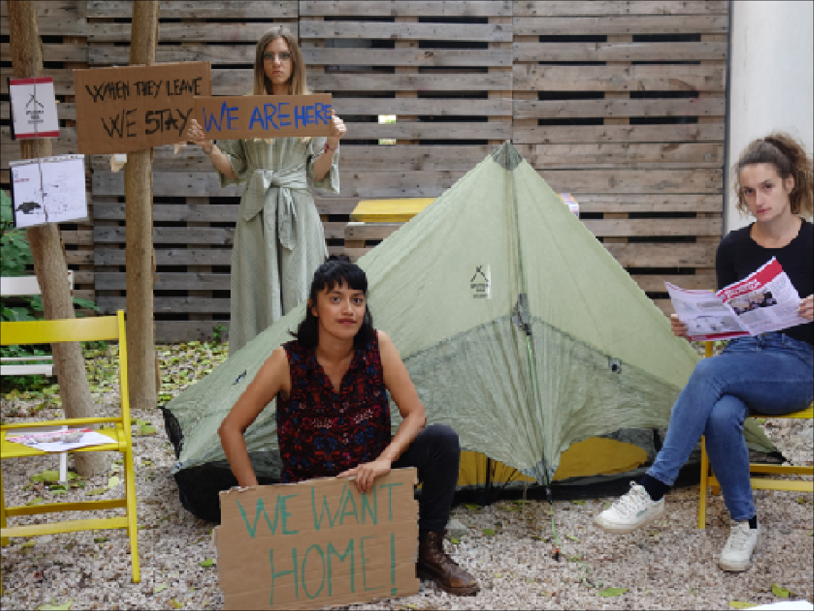
Splitska dica (Tent Community), Interakcije, Arts Academy, Split
Notes:
At a time when many young people are finding themselves increasingly unable to conceive of a future, let alone a preferable one, workshops set out to cultivate social imagination: the collective capacity to think otherwise. These speculative community responses cultivate resilience but without precluding the possibility of transformative change. Rather than aiming for predictive solutions, the workshops foreground relationality, situated knowledge, and creativity already embedded in local ways of living and dealing with uncertainty.

Slide 20
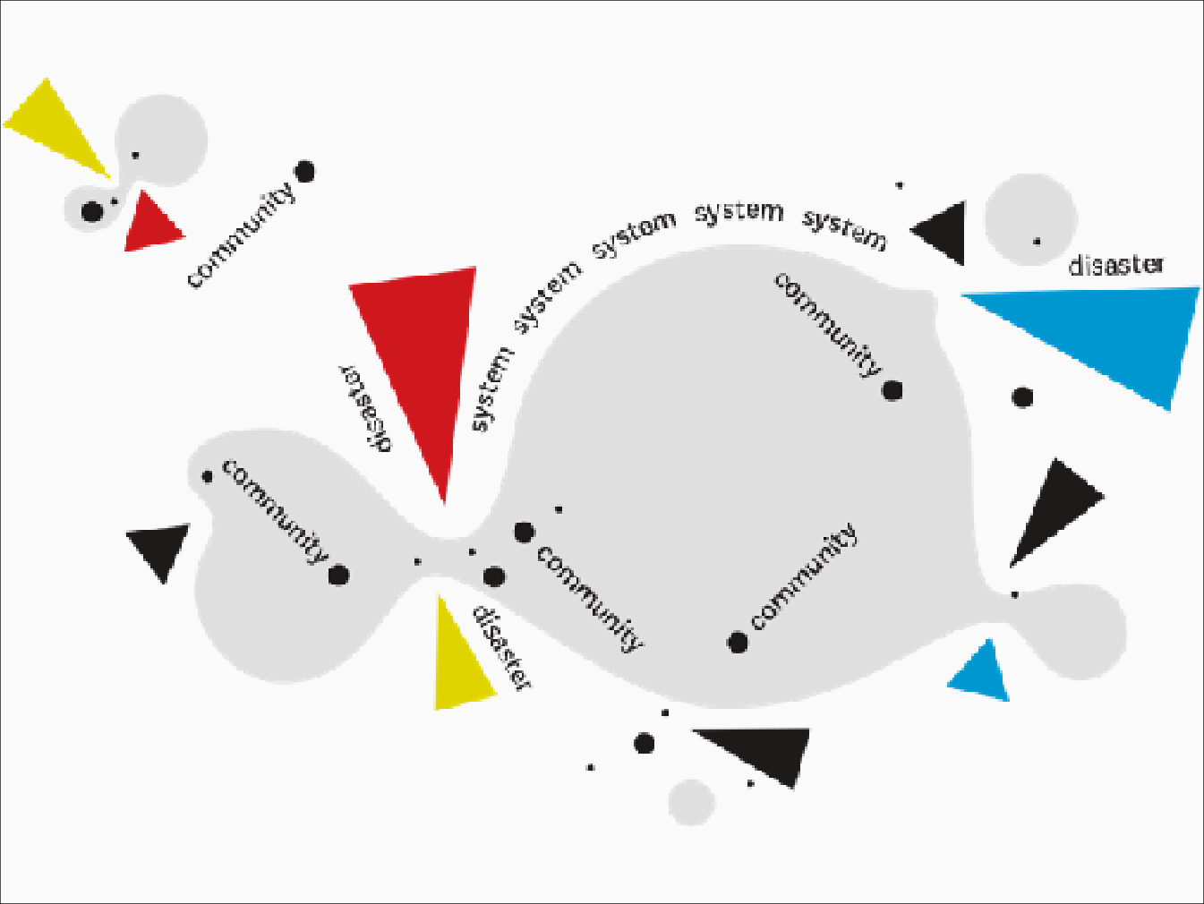
Resilience Practicum, Ivica Mitrović & Oleg Šuran, 2020 – 2021
Notes:
Bottom-up approaches such as this one rest on localized knowledge and embodied experience, yet these forms of knowing are often excluded from dominant, digitized systems of knowledge-making. As global technologies such as large language models become key mediators of information, they tend to reproduce the most statistically prevalent ideas and obscure those emerging from smaller, peripheral, or marginalized contexts.

Slide 21
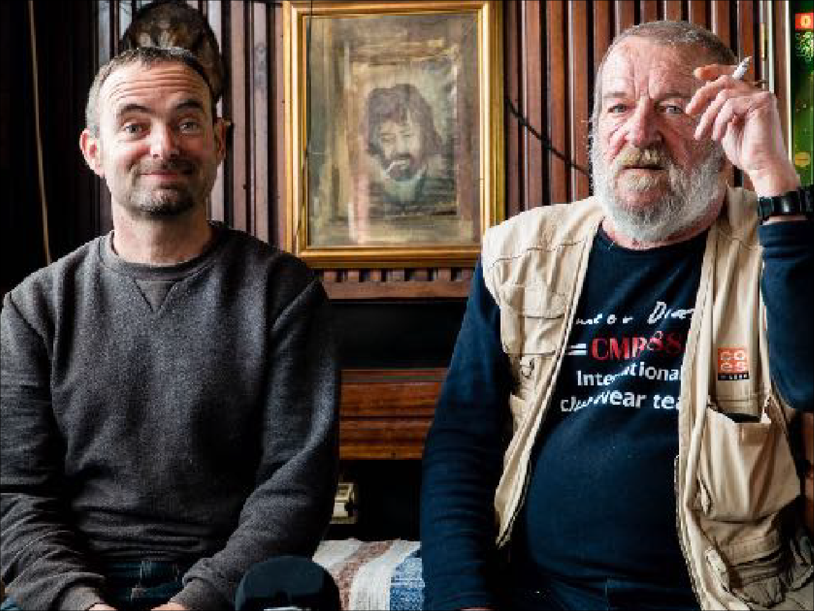
The Last Mediterranean Skipper, Mitrović & Šuran, 2017
Notes:
This produces a homogenizing effect in which diverse ways of being and knowing are flattened, and global narratives overshadow local experience, a dynamic that echoes older colonial patterns of erasing or subsuming local knowledge within dominant frameworks. The response cannot simply be to feed these systems more data. Instead, the task is to support local practices on their own terms, while avoiding romanticization.

Slide 22
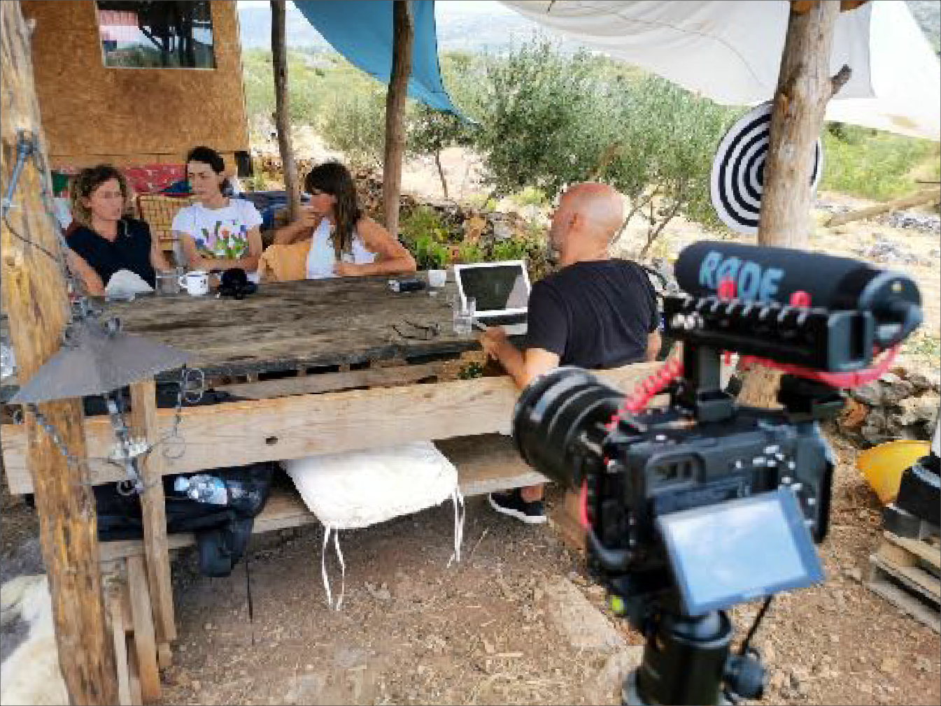
Resilience Practicum, Ivica Mitrović & Oleg Šuran, 2020-2021
Notes:
A local community is not inherently liberatory; it contains its own hierarchies and exclusions, it can suppress dissent to uphold tradition. The local is also never static and insulated; it doesn’t sit outside the global but is often informed by and entangled in its logics. As Maria Puig de la Bellacasa argued in Matters of Care, even practices of care can reproduce inequality [4]. What is needed, therefore, are spaces in which multiple epistemologies can coexist and interact, spaces that welcome conflict, negotiation, and complexity as part of shaping more just and preferable futures.

Slide 23
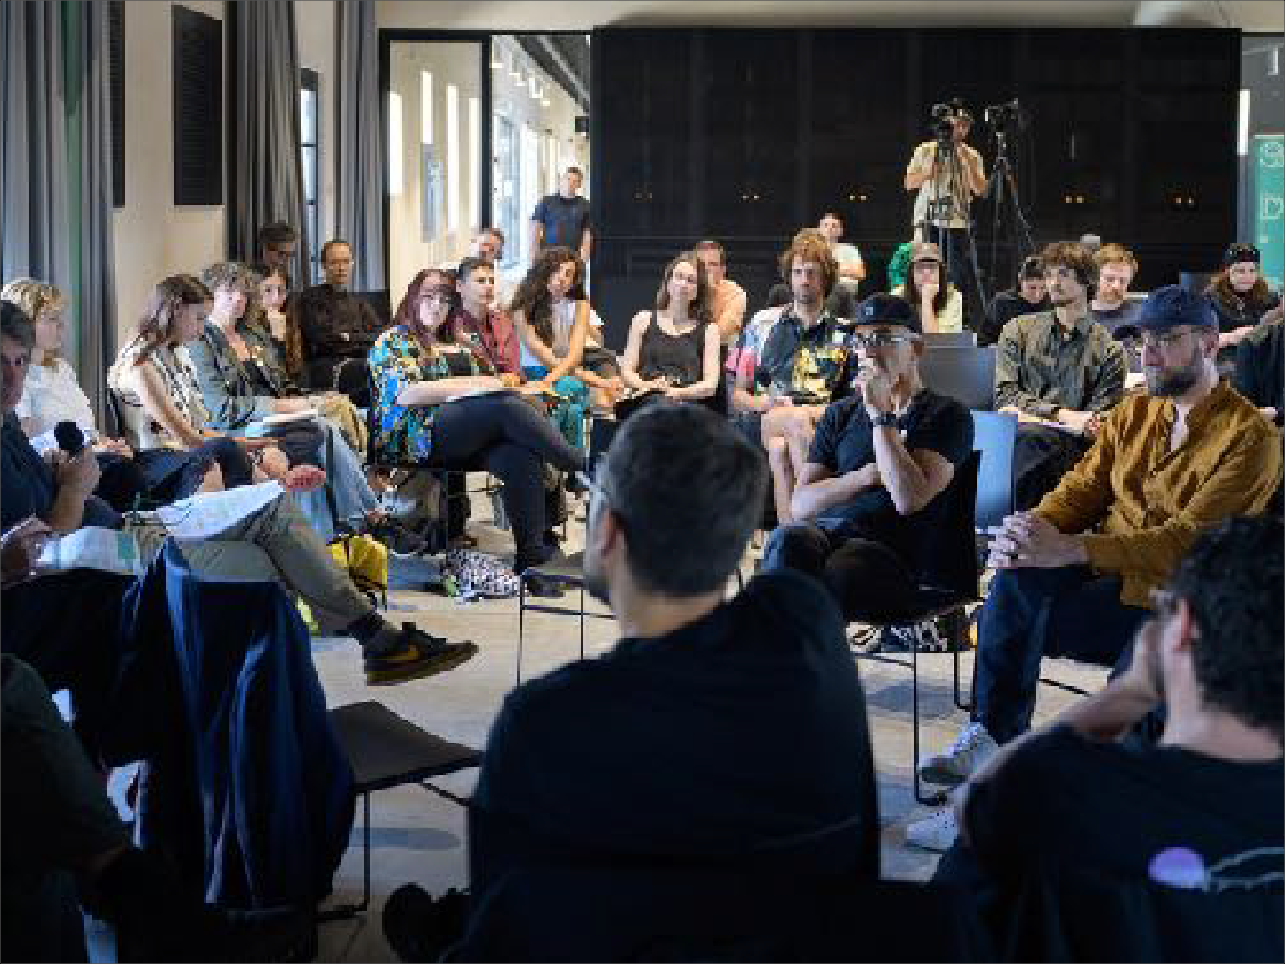
Reclaiming Hope Symposium, Nova Gorica (SLO), 2025
Notes:
To reclaim our future from the dystopian loop, we need to rethink how we imagine together. Hope, in this sense, is a collective practice—something cultivated through critical dialogue, shared experimentation, and the everyday labour of care within local contexts. As Ana Jeinić argues, an emancipatory speculative design demands an open-ended, collective praxis that forges new forms of synergy between institutional and extra-institutional actors in search of new ways of thinking and making the future.

Slide 24
“real” speculations
possible future models
to help (US/OTHERS) to understand processes and the system
to transfer further out methods, tools and techniques
to introduce cooperation instead of competitions
to local changes → global level/context
→ broader transformative results
Notes:
In our approach, which weaves together discourse and practice, education emerges as a central site for cultivating hope and supporting change. We envision the university as a speculative space, a zone for testing new forms of thinking and making. By situating educational practice in the local context—which is intimately familiar to us—and working with local people—with whom we share our everyday life, crises, and vulnerabilities on Europe’s periphery—we create conditions for reciprocity, relevance, and grounded insight. And by working with students, who will be the agents of tomorrow’s transformations, we see genuine potential for reclaiming hope: not as abstraction or optimism, but as a spark for wider emancipatory and systemic change.

Slide 25
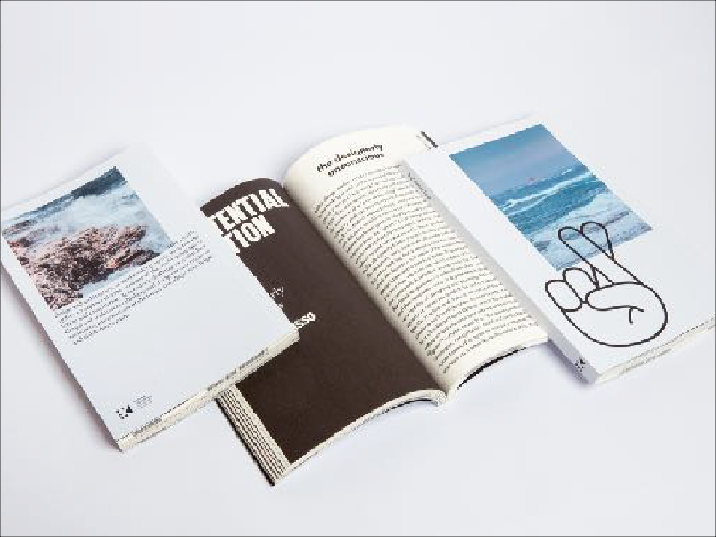
Reclaiming Hope Booklet, Nova Gorica (SLO), 2025
Notes:
Mitrović, Ivica, Mia Roth-Čerina, and Tonči Čerina, eds. 2023. Designing in Coexistence: Reflections on Systemic Change. Croatian Architects’ Association.
Mitrović, Ivica and Oleg Šuran. 2018. “Life After Tourism”. Arts Academy, University of Split. <https://interakcije.net/en/2019/02/23/life-after-tourism/>
Smith, Linda Tuhiwai. 1999. Decolonizing Methodologies: Research and Indigenous Peoples. Zed Books.
Puig de la Bellacasa, María. 2017. Matters of Care: Speculative Ethics in More Than Human Worlds. University of Minnesota Press.
Jeinić, Ana. 2021. “To What End? Rethinking Design Speculation.” Perspecta 54 (Atopia): 138-153.
Mitrović, Ivica and Dora Vanette, eds. 2025. Reclaiming Hope: Navigate(Un)Certainty, Imagine Better Futures. The Centre for Creativity, Museum of Architecture and Design, Ljubljana.

